Slide 1

Green Deal Collider: Sustainable Futures 2022
Smart Fish Counter for Automated Large-Scale Aquatic Biodiversity Monitoring in European Rivers
Laurie Hayes (MA. Technology Governance and Sustainability)
Amit Gupta (MSc. Entrepreneurship and Management)
Monika Shrestha (MSc. Software Engineering)
Mervet Kägu (LL.M and continuing education student)
Notes:
Hello. We are Team Go Fish.
Laurie Hayes (MA. Technology Governance and Sustainability)
Amit Gupta (MSc. Entrepreneurship and Management)
Monika Shrestha (MSc. Software Engineering)
Mervet Kagu (LL.M and continuing education student)
We're here representing a brilliant team of scientists and software developers who have reached out to us to help them put together an innovative business plan.

Slide 2
WE LIKE FISH
Notes:
Beat, pause for laughs?

Slide 3
FISH INNOVATORS
Notes:
Through the Green Deal Collider, we’ve had a fantastic opportunity to collaborate with Jeff and Vanessa who came to us with an interesting project to monitor the biodiversity of fish in rivers.
Their team has developed an automated fish counting software that, with a river-based camera system, monitors fish migration in European rivers. This is important for measuring impact of industrial practices and governmental policies on waterways, enabling the protection and restoration of migrating fish populations and environments.
However, when it comes to measuring, contextualising, and remedying the impacts of the climate emergency, the focus of investments and policies has been on CO2.

Slide 4
WE DON’T CARE ABOUT CO2
Notes:
Biodiversity is also an integral part of the United Nation Sustainable Development Goals. While the world is closely following the developments of COP27 - then did you know that there is also a World Biodiversity Summit starting tomorrow at Sharm el-Sheikh and continues in Montreal in December that focuses on biodiversity preservation?
Simply put, reporting on biodiversity is where reporting on climate change was 5 to 10 years ago: the early stages of measurement, monitoring, and - yes - monetization of environmental solutions.
However, one problem that investors point out is that there is no standard methodology for assessing and reporting biodiversity.
And here’s where BFG project can help.

Slide 5
One in eight plant and animal species are on the verge of extinction
One third of amphibian, reef-forming corals, and marine mammals are threatened
Average abundance of native species in land-based habitats down 20% since 1900
At least 680 vertebrate species are already gone
Notes:
So, we all know that our sweet earth is not doing so well.
Aside from the ice caps melting and meteors becoming crashed into us, the Anthropocene era has already witnessed incredibly alarming impacts of our actions.
However, people struggle with concepts this large and existential, and may feel like they're too small - or it's too late - to do anything.
Some cope with memes...

Slide 6
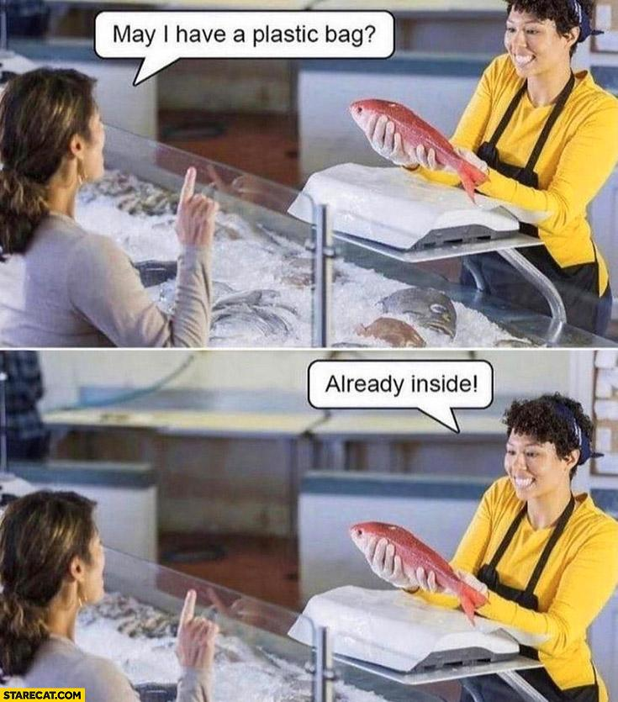
Notes:
*hoping for some LOLs from the audience*

Slide 7
SO WE’RE DOOMED?
Notes:
When the memes don’t cut it, though - we start looking for solutions.
What it comes down to is that we can’t monitor what we don’t measure - and if we can’t attach meaningful numbers to what we want to measure, it’s incredibly difficult to contextualise it to the money people, and therefore to get traction for wider usage.
Our project, rather than introducing a new technology, instead looked at how we can bring attention and investment to the need for monitoring biodiversity, and the value of regular, relevant data collection and analysis.

Slide 8
THEN WHO CAN FIX THIS?
Notes:
Our client’s known potential clients included governments and industries with regulatory obligations - hydroelectric power plants, for example, have a responsibility to not damage to the river environments in which they operate.
Through reframing exercises as part of the course, we were able to branch out beyond those expectations, and turn the focus from the software and camera, to the data that’s collected. When we look at the data as a separate product, then we open up entirely new revenue streams, inviting product adoption and investment from entirely new parties.
Governments
Regulated industries
Adjacent industries
NGOs and environmental organisations
Local communities
Investors
The company can attract investment by using sustainable investment options such as looking for impact investors, biodiversity offset projects, blue bonds etc to keep it functioning.
According to numerous reports, investors are now waking up to the investment opportunities around biodiversity.
Market research shows, that by September 2022 over of the world’s 75 largest asset managers, none had a dedicated policy on biodiversity, and only 11% of asset managers had policies requiring portfolio companies to mitigate harmful impacts on biodiversity.
Requirements related to biodiversity preservation are still being developed by the EU, so this is a big potential to work with the EU already now
Not only that, but the project owners could partner with numerous NGOs working for the protection of aquatic biodiversity and sell our data to keep our business running.
Identified new revenue streams
We identified that, rather than focusing just on selling the device and software, the company could also sell the data on a subscription basis.
This will allow the company to continue producing revenue even when its contract with the German government expires.
Taxonomy Regulation also considers mitigating underwater noise and vibration as a important part of biodiversity preservation, hence this is something the project owners could consider when developing their product further.
Competitor and market analysis
We identified competitors on the market, both small and big - however we believe that the market is not saturated yet
Big tech companies are increasingly interested in ways how to monitor biodiversity, such as Huawei.
Hence potential idea is to approach the competitors of Huawei with the solution, either as a client or as a potential opportunity to sell the company to them
Impact
[NEEDS INPUT - Can the solution be scalable to a wider part of the population? To what extent does the idea/solution contribute to a more sustainable future from an environmental, social, economic (measurability?) perspective?]
Novelty
[NEEDS INPUT - Are you presented evidence of tangible solution?]
Feasibility
[NEEDS INPUT - Are you presented evidence of tangible solution? Are you provided convincing elements that support the solution’s deployability?]
Inclusivity
We have involved stakeholders involved in the process of the solution development and how were they chosen?
Are the users’ perspectives integrated in the solution?
Are multiple disciplines taken into consideration in the development of the solution? (engineering perspective, sociological perspective, etc.)
23 stakeholders have opened the email and we have received replies from 2.
Because we have established technology and a client base, we can conclude that the technology is feasible.
The most innovative components of our strategy (blue bonds, data access services) are novel in this context, but their existence in other domains demonstrates the validity of individual solutions.
Following receipt of our survey responses that we will share with the project owners to analyze the results and provide offers to the customer based on a roadmap of product/service offerings over several years, allowing time to build those components that are scalable to all river systems.
We intend to hire more ichthyologists to train the data as the loads and locations expand since we intend to build our device in such a way that it can be used to monitor fish movement not only in rivers but also in seas, lakes, and ports, among other places.
Continuous collaboration with the team and project owners
Updates and calls with the project owners
Proactively seeking feedback from the market, potential clients and investors
Participation in class
Next steps
Following receipt of our survey responses, we sguggest to analyze the results and provide offers to the customer based on a roadmap of product/service offerings over several years, allowing time to build those components that are scalable to all river systems.
We suggest to hire more ichthyologists to train the data as the loads and locations expand since we intend to build our device in such a way that it can be used to monitor fish movement not only in rivers but also in seas, lakes, and ports, among other places

Slide 9
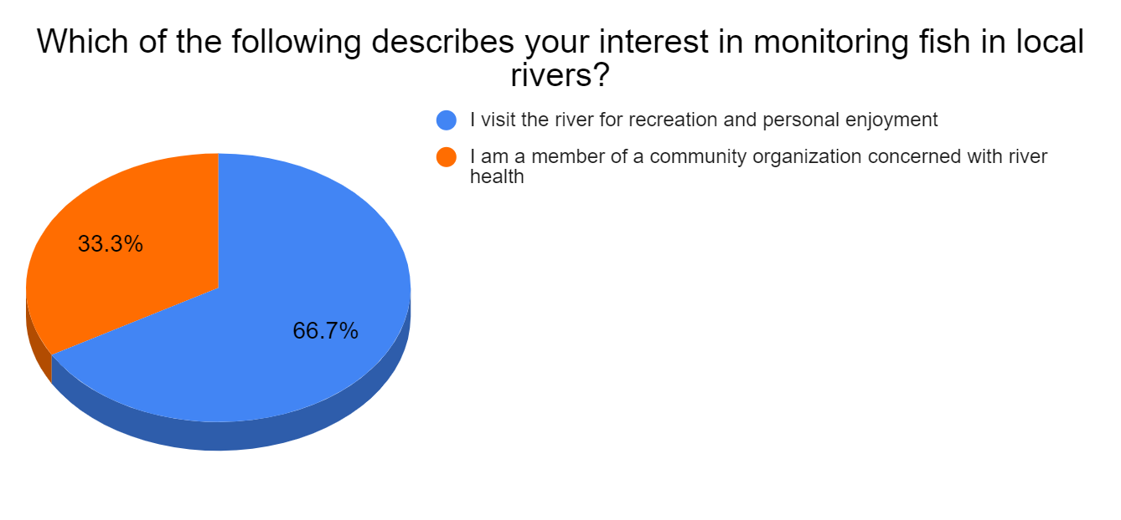
Notes:
We put together a survey that we sent to 110 potential clients and investors (regulated industries, NGOs, policy makers, research institutions, (impact) investors etc)

Slide 10
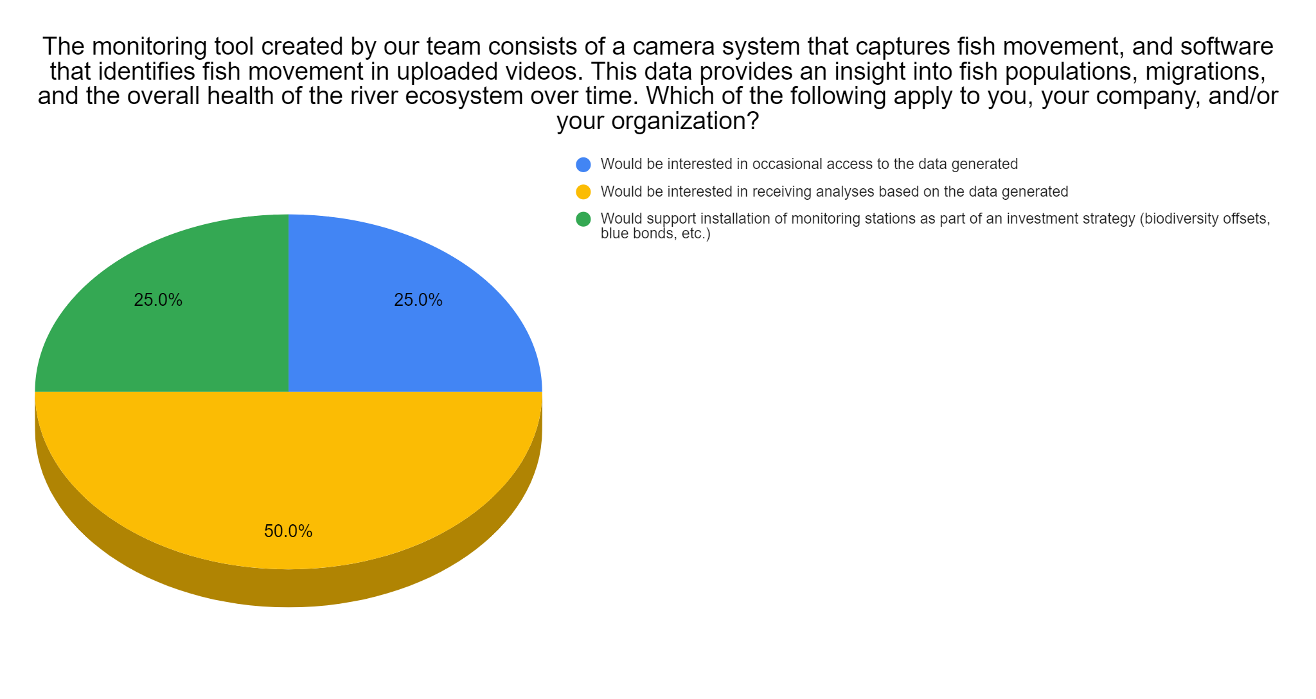
Notes:
[NEEDS INPUT
Description of to whom we sent the survey to? Why them?
What did we ask?
What did they respond?
Key takeaways from the survey
Next steps]

Slide 11
WHERE TO NEXT?
Notes:
Following receipt of our survey responses that we will share with the project owners to analyze the results and provide offers to the customer based on a roadmap of product/service offerings over several years, allowing time to build those components that are scalable to all river systems.

Slide 12
HOW DO WE GET THERE?
Notes:
Market research
Development planning
More ichthyologists as environments grow
We intend to hire more ichthyologists to train the data as the loads and locations expand since we intend to build our device in such a way that it can be used to monitor fish movement not only in rivers but also in seas, lakes, and ports, among other places.

Slide 13
KEY TAKEAWAYS
Interest in biodiversity monitoring is growing
Prioritise industries with regulatory due diligence
Monetise generated data
Look for (impact) investors and companies interested in sustainable investments
Collaboration with big tech companies
Ever problem comes with a solution and opportunities to monetize them
Notes:
Interest in biodiversity monitoring is growing - however the methodologies and technology to measure it are lagging 10 years behind CO2 measuring.
Prioritise industries that have regulatory due diligence requirements to monitor biodiversity
Rather than focusing just on selling the fish counter device and software - the company could also sell the data on a subscription basis
Look for impact investors and companies interested in issuing blue bonds and/or Taxonomy-alignment
Partner up (or potentially sell) the product to bigger tech companies, who have the resources to develop the product further
Every problem comes with a solution and has potential ways how to monetize the situation

Slide 14
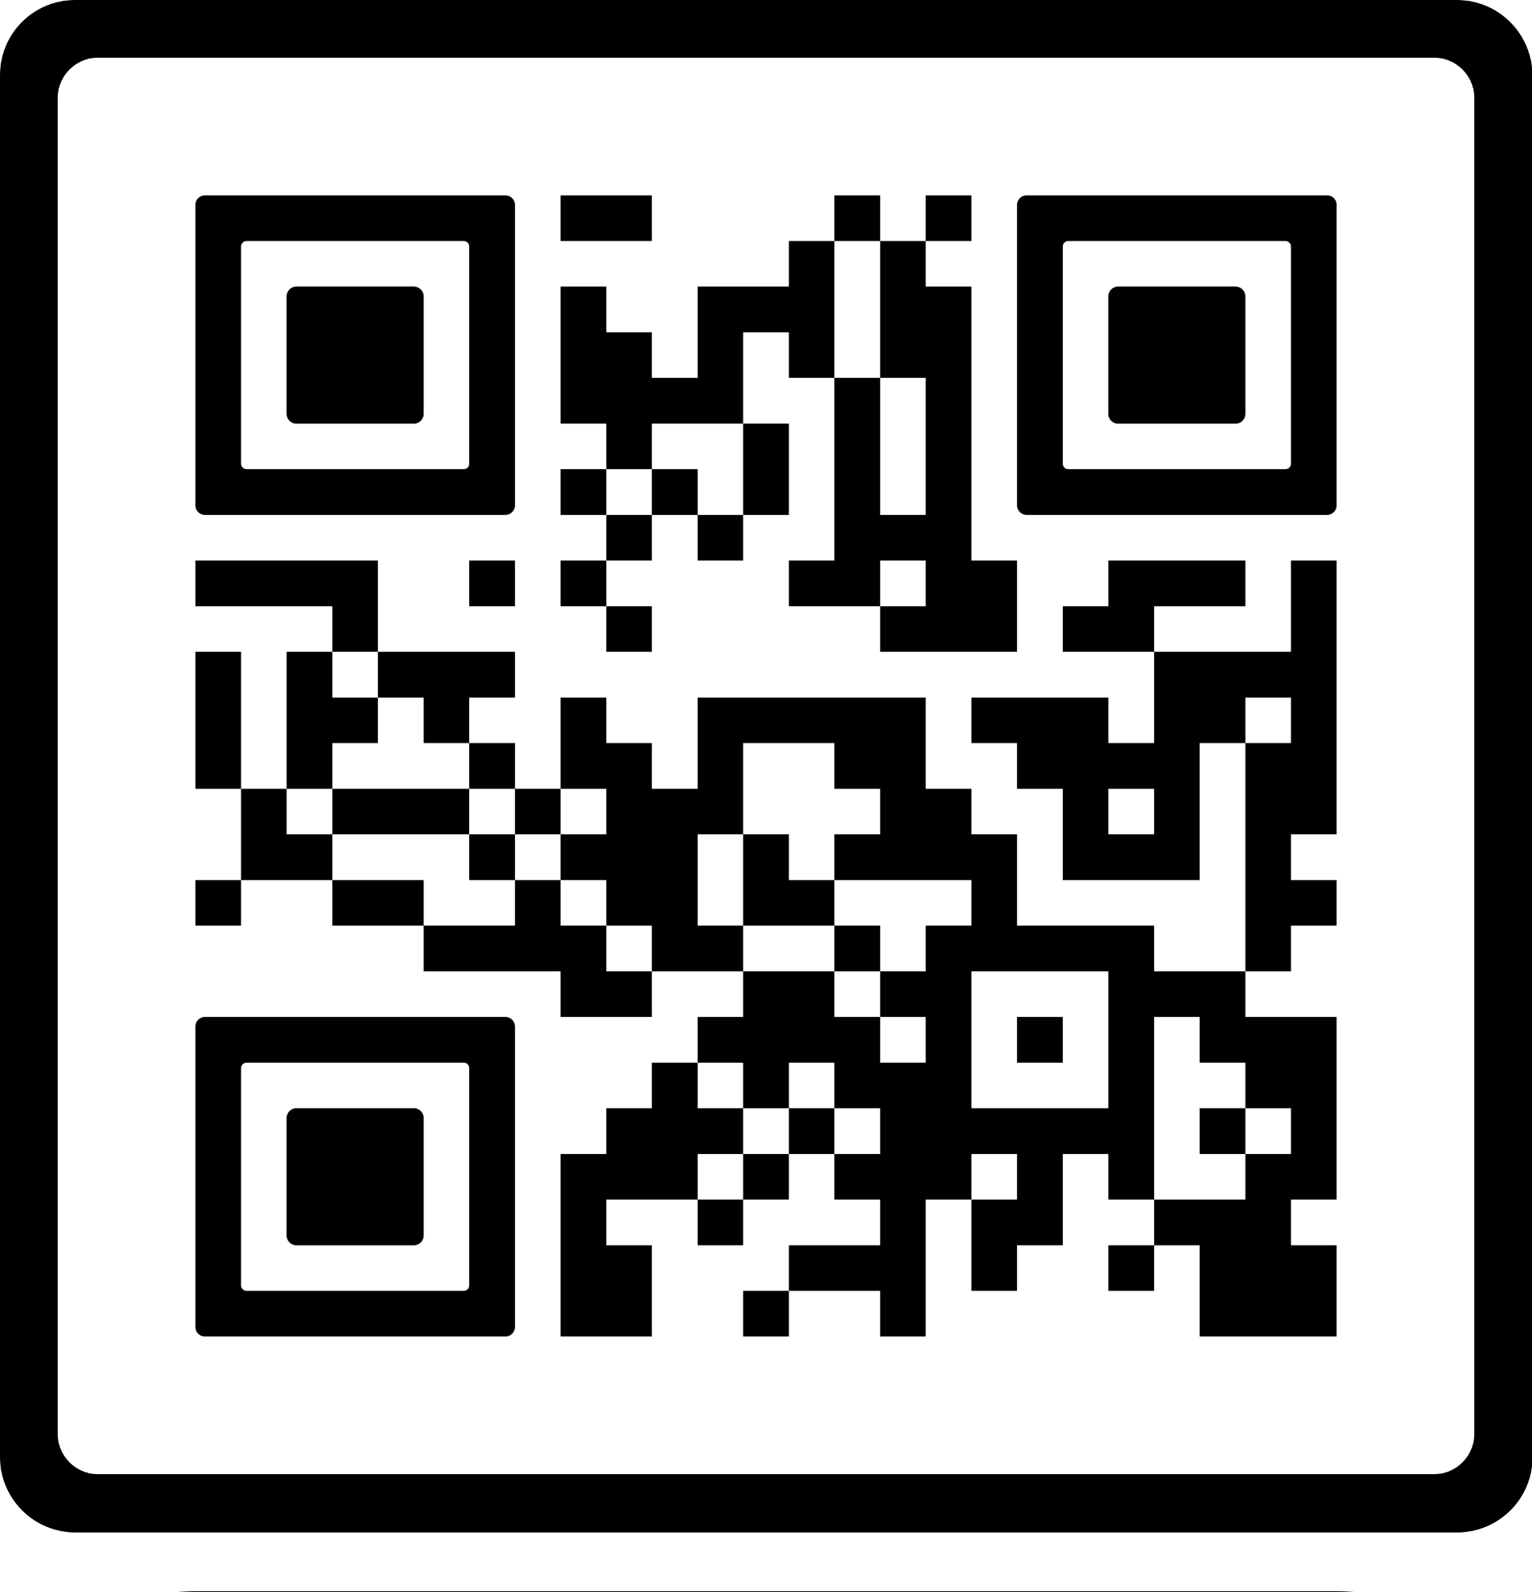
SO LONG, AND THANKS FOR ALL THE FISH!
Team at BFG:
Jeffrey Andrew Tuhtan: jeffrey.tuhtan@taltech.ee
Isis Vanessa Navarro Rivas: isis.navarro@taltech.ee
Students:
Laurie Hayes: lahaye@taltech.ee
Amit Gupta: amgupt@taltech.ee
Monika Shrestha: moshre@taltech.ee
Mervet Kägu: mekagu@taltech.ee
Take the survey here!
Notes:
Thank the project owners, our lecturers and guest lecturers and to our fellow students for interesting ideas and discussions.
Invite people to access the survey behind the QR code.

